Slide 1


Slide 2


Guess the Five letter word from the below two images
R
N

Slide 3
Guess the Five letter word from the below two images
B
R
I
N
G

Slide 4
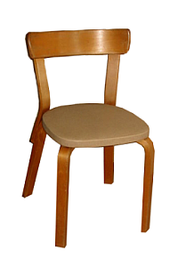

Guess the 8 letter word from the below two images
C
M

Slide 5
Guess the 8 letter word from the below two images
C
H
A
I
R
M
A
N

Slide 6

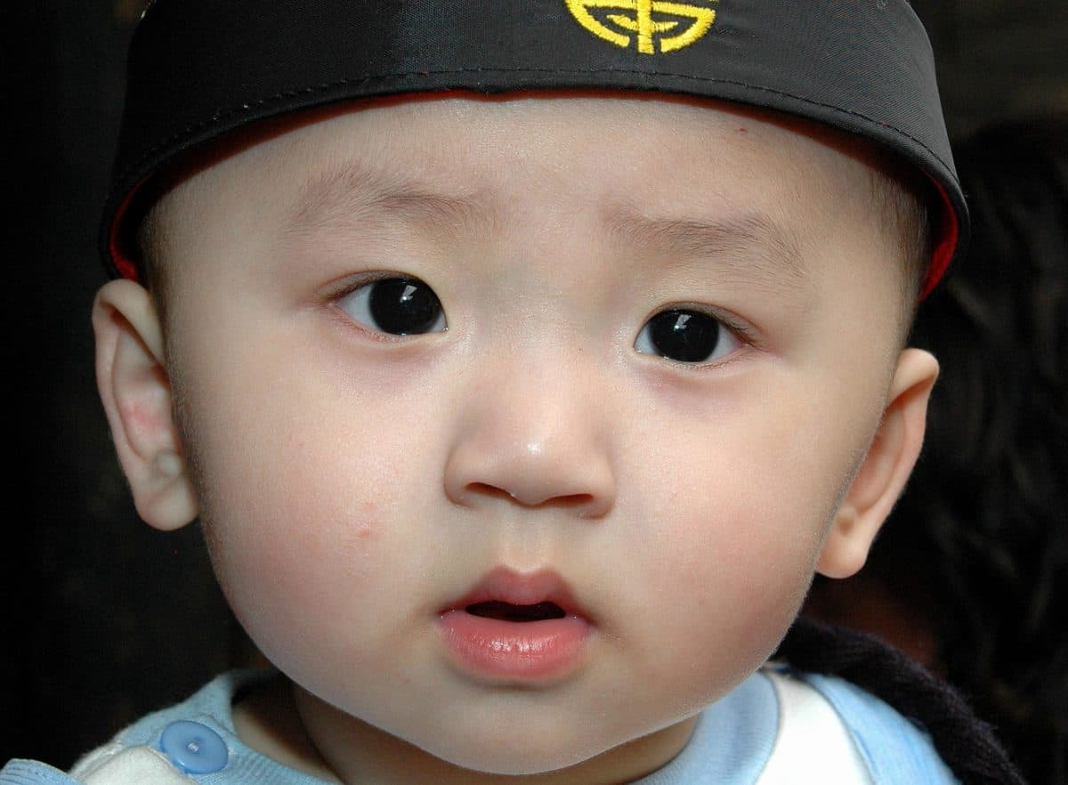
Guess the 8 letter word from the below two images
F
E
K

Slide 7
Guess the 8 letter word from the below two images
F
A
C
E
B
O
O
K

Slide 8
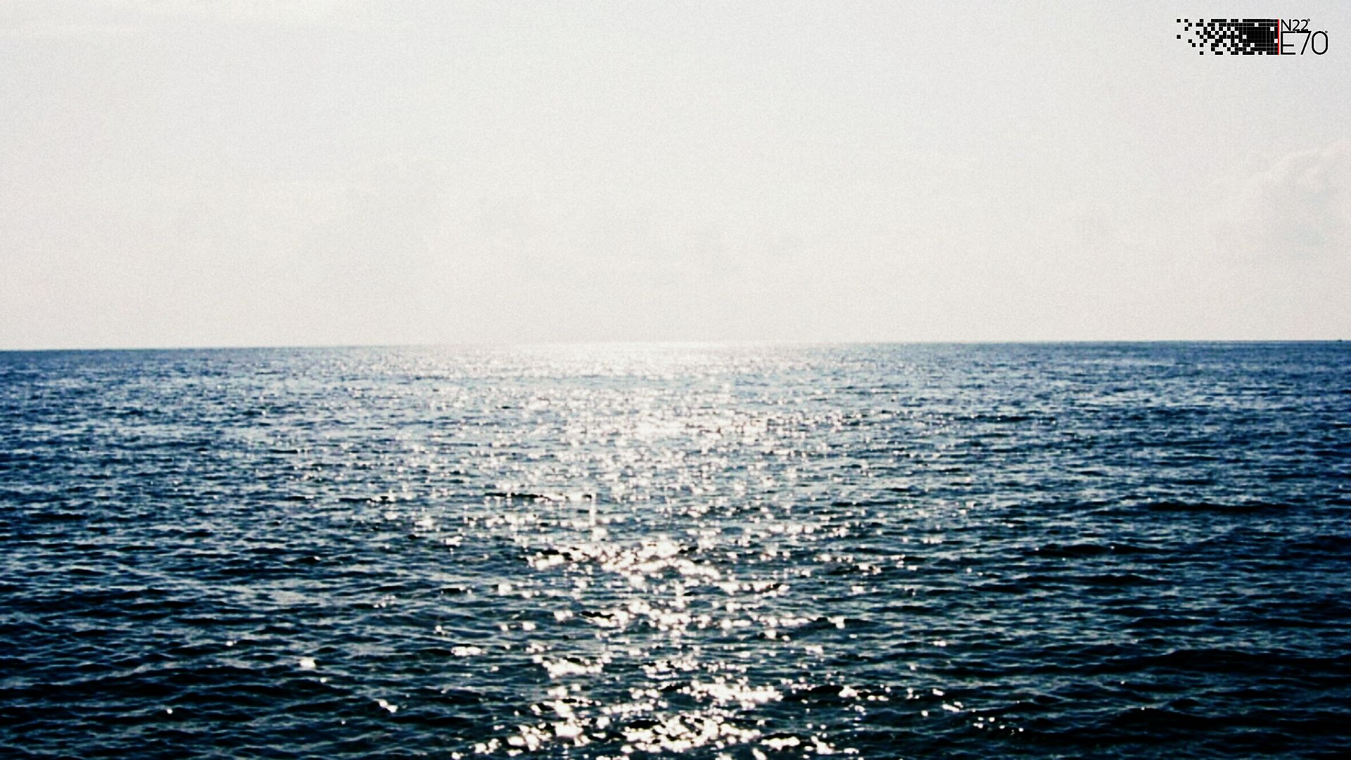

Guess the 6 letter word from the below two images
S
N

Slide 9
Guess the 6 letter word from the below two images
S
E
A
S
O
N

Slide 10

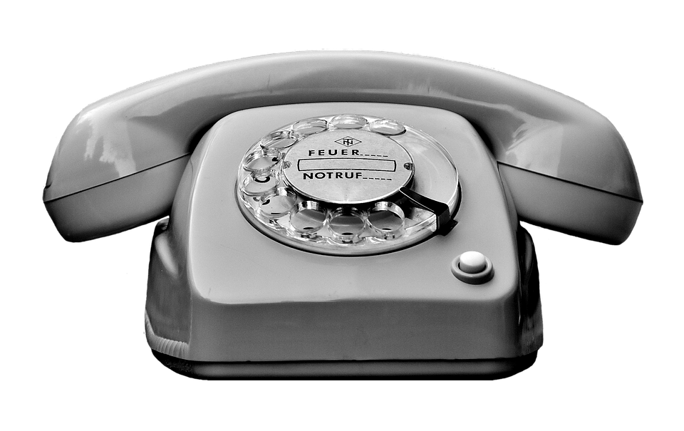
Guess the 6 letter word from the below two images
0

Slide 11
Guess the 6 letter word from the below two images
I
P
H
0
N
E

Slide 12

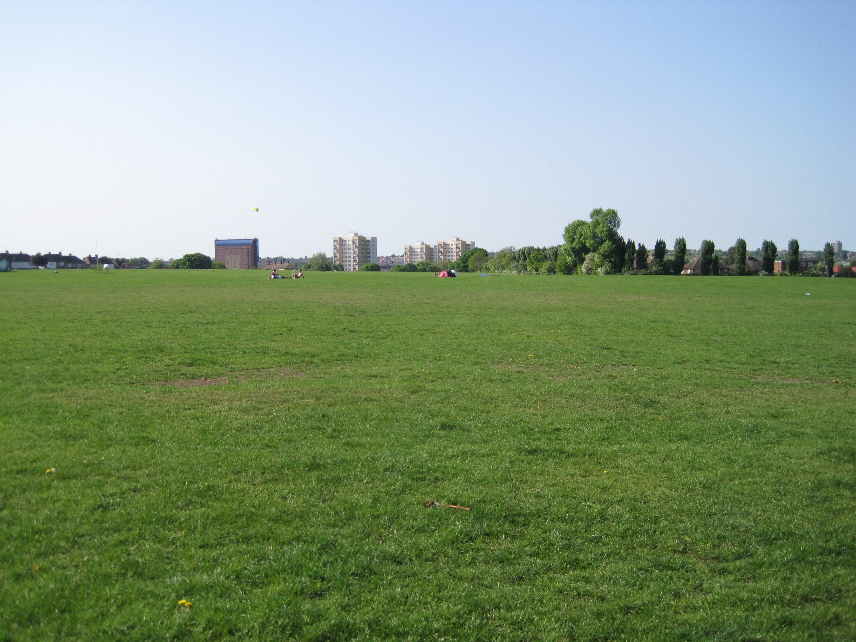
Guess the 10 letter word from the below two images
K
0

Slide 13
Guess the 10 letter word from the below two images
B
A
C
K
G
R
0
U
N
D

Slide 14


Guess the 4 letter word from the below two images
N

Slide 15
Guess the 4 letter word from the below two images
W
A
N
T

Slide 16
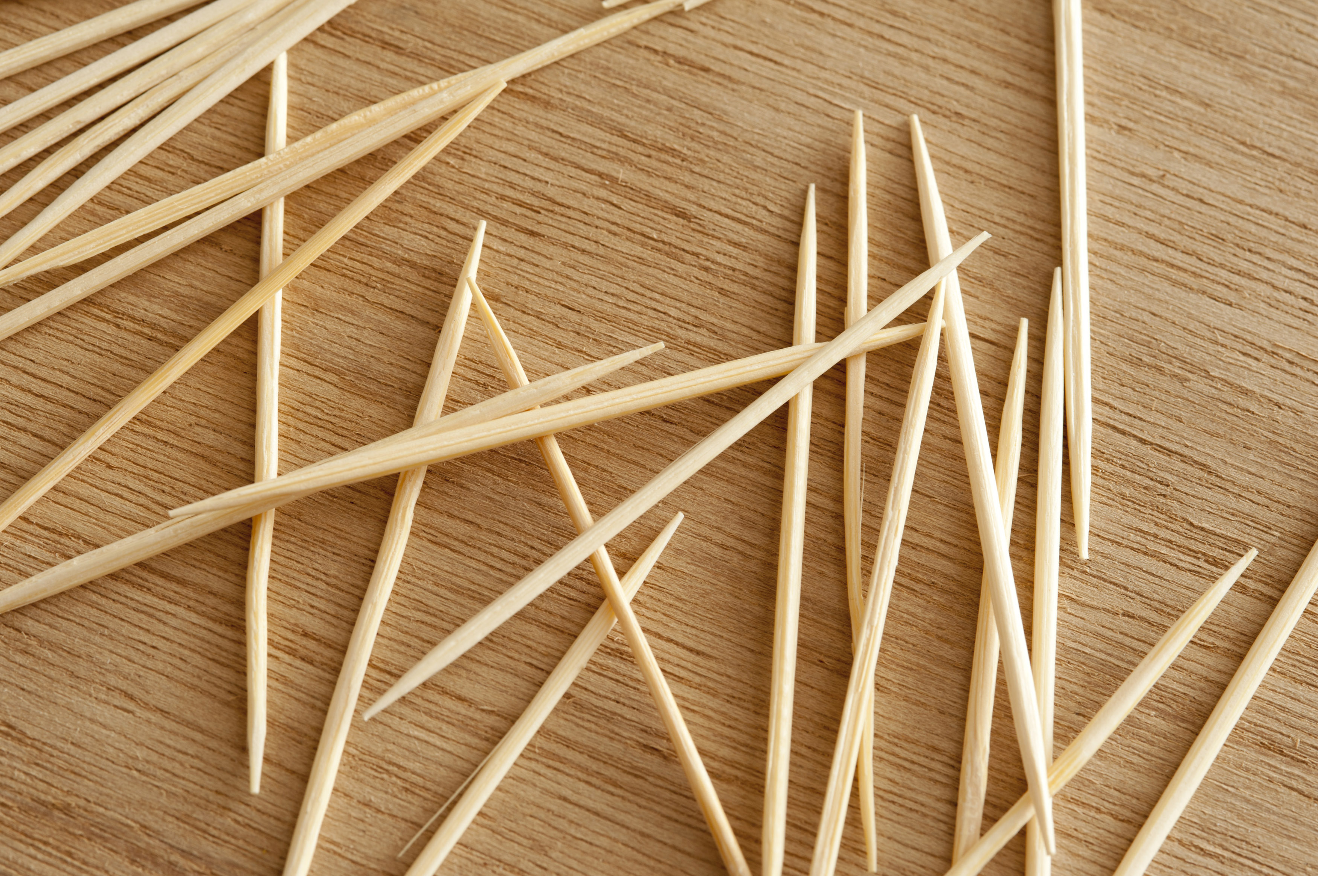

Guess the 9 letter word from the below two images
T
This Photo by Unknown Author is licensed under CC BY

Slide 17
Guess the 9 letter word from the below two images
L
I
P
S
T
I
C
K
S
This Photo by Unknown Author is licensed under CC BY

Slide 18
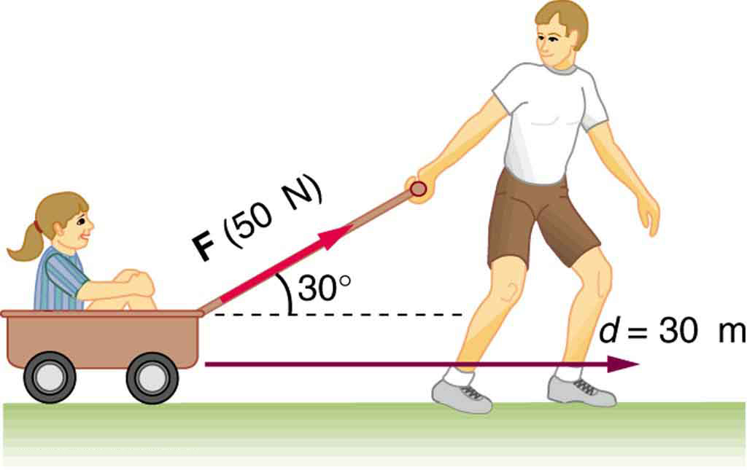
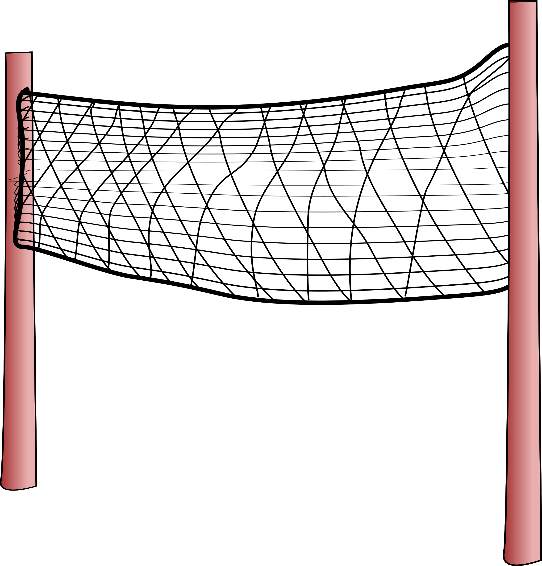
Guess the 7 letter word from the below two images
0
K

Slide 19
Guess the 7 letter word from the below two images
N
E
T
W
0
R
K

Slide 20


Guess the 7 letter word from the below two images
H
S
Y
This Photo by Unknown Author is licensed under CC BY-SA

Slide 21
Guess the 7 letter word from the below two images
H
I
S
T
O
R
Y
This Photo by Unknown Author is licensed under CC BY-SA

Slide 22


Guess the 7 letter word from the below two images
P

Slide 23
Guess the 7 letter word from the below two images
P
O
P
C
O
R
N

Slide 24
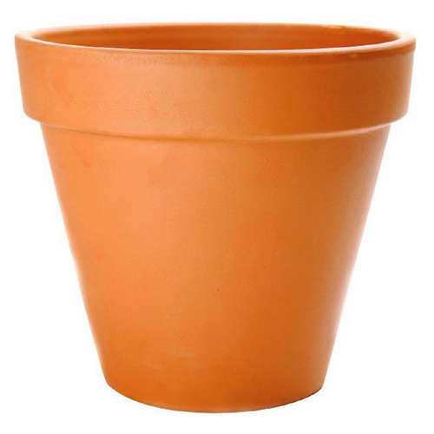


Guess the 6 letter word from the below three images
A

Slide 25
Guess the 6 letter word from the below three images
P
O
T
A
T
O

Slide 26
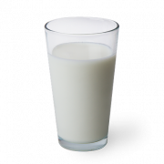

Guess the 9 letter word from the below two images
K
A

Slide 27
Guess the 9 letter word from the below two images
M
I
L
K
S
H
A
K
E

Slide 28


THANK YOU

